Slide 1
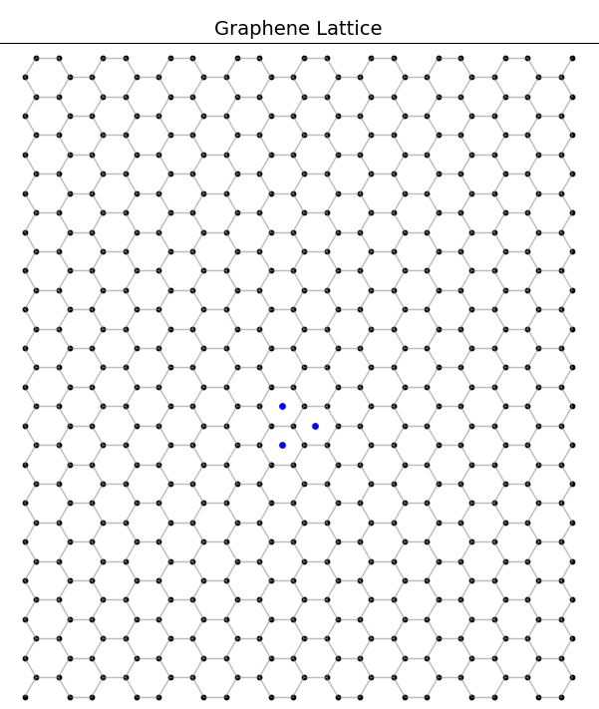
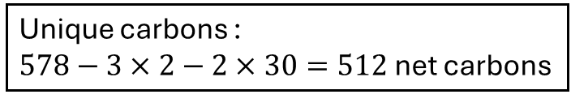
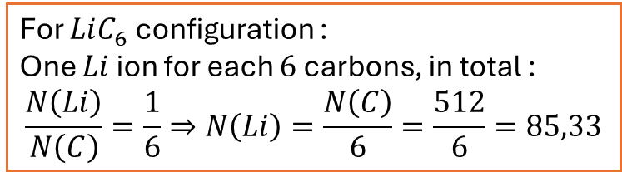
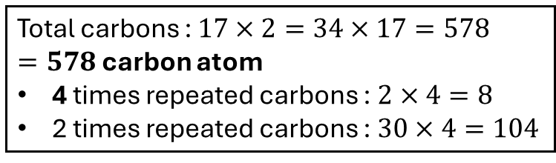
Corner carbons are counted 4 times
➔ Remove them 3 times
Carbons at the edges are counted 2 times
➔ Remove them 1 time
Total carbons :
carbon atom
4 times repeated carbons : $2×4=8$
2 times repeated carbons : $30×4=104$
Unique carbons :
$578−3×2−2×30=512$ net carbons
For $LiC_{6}$ configuration :
One $Li$ ion for each $6$ carbons, in total :
$$\frac{N\left(Li\right)}{N\left(C\right)}=\frac{1}{6}⇒N\left(Li\right)=\frac{N\left(C\right)}{6}=\frac{512}{6}=85,33$$

Slide 2
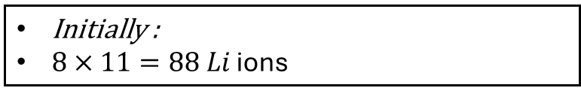
VERFIFICATION
Initially :
$8×11=88$ $Li$ ions

Slide 3
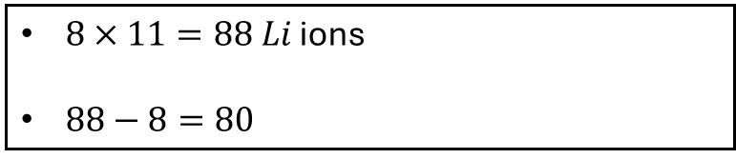
VERFIFICATION
$8×11=88$ $Li$ ions
$88−8=80$

Slide 4
VERFIFICATION
$8×11=88$ $Li$ ions
$88−8=80$

Slide 6
Seconde proche voising
0 1 2 3 4 5 6 7
16 17 18 19 20 21 22 23
8 9 10 11 12 13 14 15
0 1 2 3 4 5 6 7

Slide 7
Troisième proche Voisin
0 1 2 3 4 5 6 7
16 17 18 19 20 21 22 23
8 9 10 11 12 13 14 15
0 1 2 3 4 5 6 7

Slide 8

